Slide 1
Control of an Inverted Pendulum Environment Through Various Agents
By Buta B13
Notes:
Hi everyone, I am Buta from B13 and welcome to my presentation. Firstly, I want to take some time to give you context on this presentation. I know some of you do not have background in computer science. I think you will be happy to hear that I will not go into any technical details in this presentation, instead I will be focusing on the concepts and ideas behind my project. For those of you who have an interest in artificial neural networks or evolutionary algorithms, you can ask me for a copy of my report on another date.
Next, I want you to focus on the title of this presentation. What does this mean?

Slide 2
Control of an Inverted Pendulum Environment Through Various Agents
By Buta B13
Notes:
Well, “control of an inverted pendulum” looks like this.

Slide 3
Vid 1

Slide 4
Vid 1

Slide 5
Control of an Inverted Pendulum Environment Through Various Agents
By Buta B13
Notes:
Ok, what about the words “environment” and “agent”, what do these words mean?

Slide 6
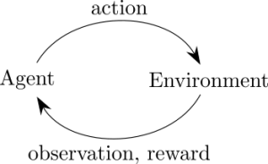
Key Terms
Notes:
An Agent takes an action in its environment, which affects the environment in some way. The agent receives back new information depending on the action it took, such as observations or rewards.

Slide 7

Key Terms
Notes:
Here is a simple, relatable example for everyone. In this example, the agent is the human and the environment is the world he is in. The action the agent took is cooking his food, he observes is the difference in color and smell of the food and his reward is better nutrition and survivability.

Slide 8
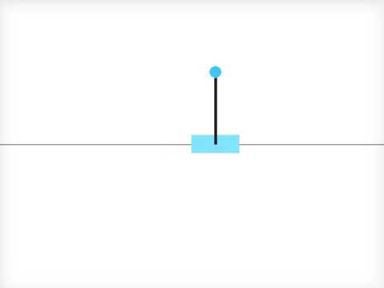
Key Terms
Notes:
In this project, the environment is a virtual inverted pendulum program and the agents used are control systems.
https://i.ytimg.com/vi/cvQiz8VpGVo/hqdefault.jpg

Slide 9
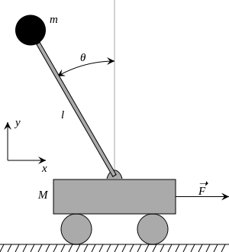
Aims And Objectives
Notes:
According to the title, the objective should be to gain control of the environment. However, the word "Control" can be quite vague. At what point can we say that control of the environment is gained? In this project, the objective changes depending on the agent used. But the overall theme is clear and simple: something along this line.

Slide 10
Vid 1

Slide 11

Motives: Why This Project?
Notes:
Ok, Ok. You get the idea now. But, Why is it important to balance a pendulum in the first place?

Slide 12




Motives: Why This Project?

Slide 13

Agents
Notes:
Now, I will be getting into the main part of this presentation. I will introduce you to the types of agents used during my my project.

Slide 14
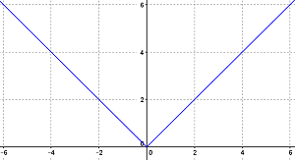
Hard Code
Notes:
Hard code is a form of control system where the programmer directly indicates to the agent its intended behavior from every observation. Basically, when we tell the program beforehand exactly what it should do in any circumstance. You may have already wondered how balancing a 2-dimensional pendulum could be that challenging; can we not just tell it to apply a force the opposite direction to its angle? For example, if the pendulum is leaning to the left, we apply a force to the left, how hard could it be? Right?

Slide 15
Hard Code
Video
Notes:
Well, not so fast. This is the kind of result we would get from using that method. If this looks like simple harmonic motion to you, then you are correct. This method does keep the pendulum from falling, but does not give us adequate “control” over it. In reality, where drag forces are involved, this method would keep on wasting electrical energy as the cart would have to always exert force. This is not a practical solution and we will need something smarter.

Slide 16
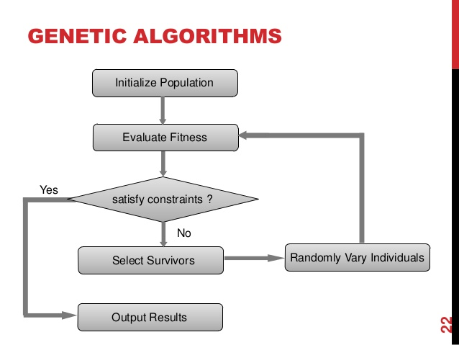
Genetic Algorithm
Notes:
Next, I experimented with the idea of genetic algorithm. Genetic algorithm was conceptualised from evolution as we know it.

Slide 17
Genetic Algorithm
video

Slide 18
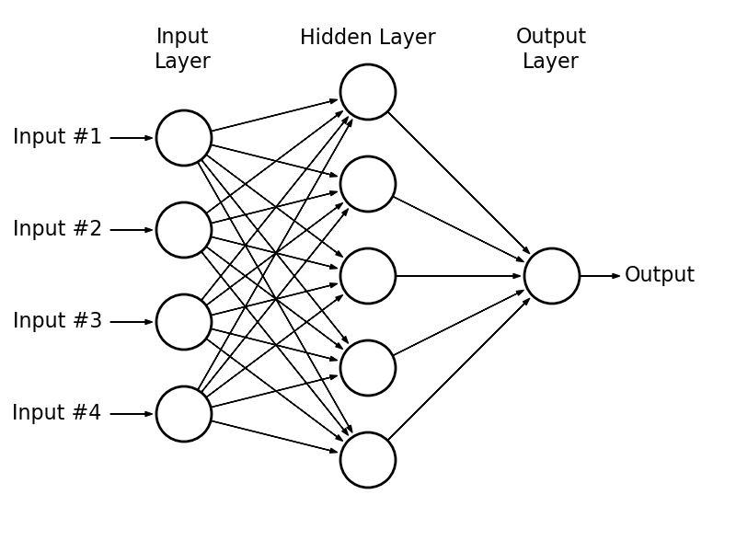
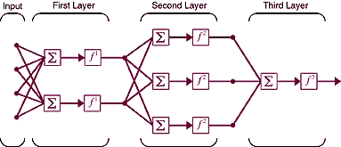
Artificial Neural Networks

Slide 19
Artificial Neural Networks
video

Slide 20
Conclusion

